Slide 1

Deploying Application on HPC cluster by using internal CI-CD Pipeline Post Graduate Diploma in High Performance Computing System Administration from C-DAC ACTS (Pune)
Guided by
Mr.Pratik Maheshwari
Presented By
Mr. Sandeep Kamble
Mr. Pranav Ambhore
Mr. Mithlesh Murmu
Mr. Siddharth Birajdar
PRN : 230940127048
PRN : 230940127044
PRN : 230940127041
PRN : 230940127012

Slide 2
Introduction
This Project aims to implement Continuous Integration and Continuous Deployment using Jenkins to Deploy Applications on High Performance Computing Cluster.
Technologies Used
Jenkins
xCAT
NFS
Slurm
Iptables
Python Program

Slide 3
Implementation
For implementing CI-CD Pipeline to deploy app on HPC cluster we needed Jenkins to work on one machine which will deploy application on HPC cluster.
While HPC cluster had to be made for that. To make HPC cluster we needed xcat to provision node OS and then perform routing for the nodes via xcat machine (here we call it HPC Master) while its nodes are compute nodes.

Slide 4
System Requirement
Hardware Requirement
Cent OS 7 30GB HD, 4 GB RAM
Used Languages
1. Python
Software Requirement
GIT
Jenkins
xCat
Iptables
Slurm
Nfs

Slide 5
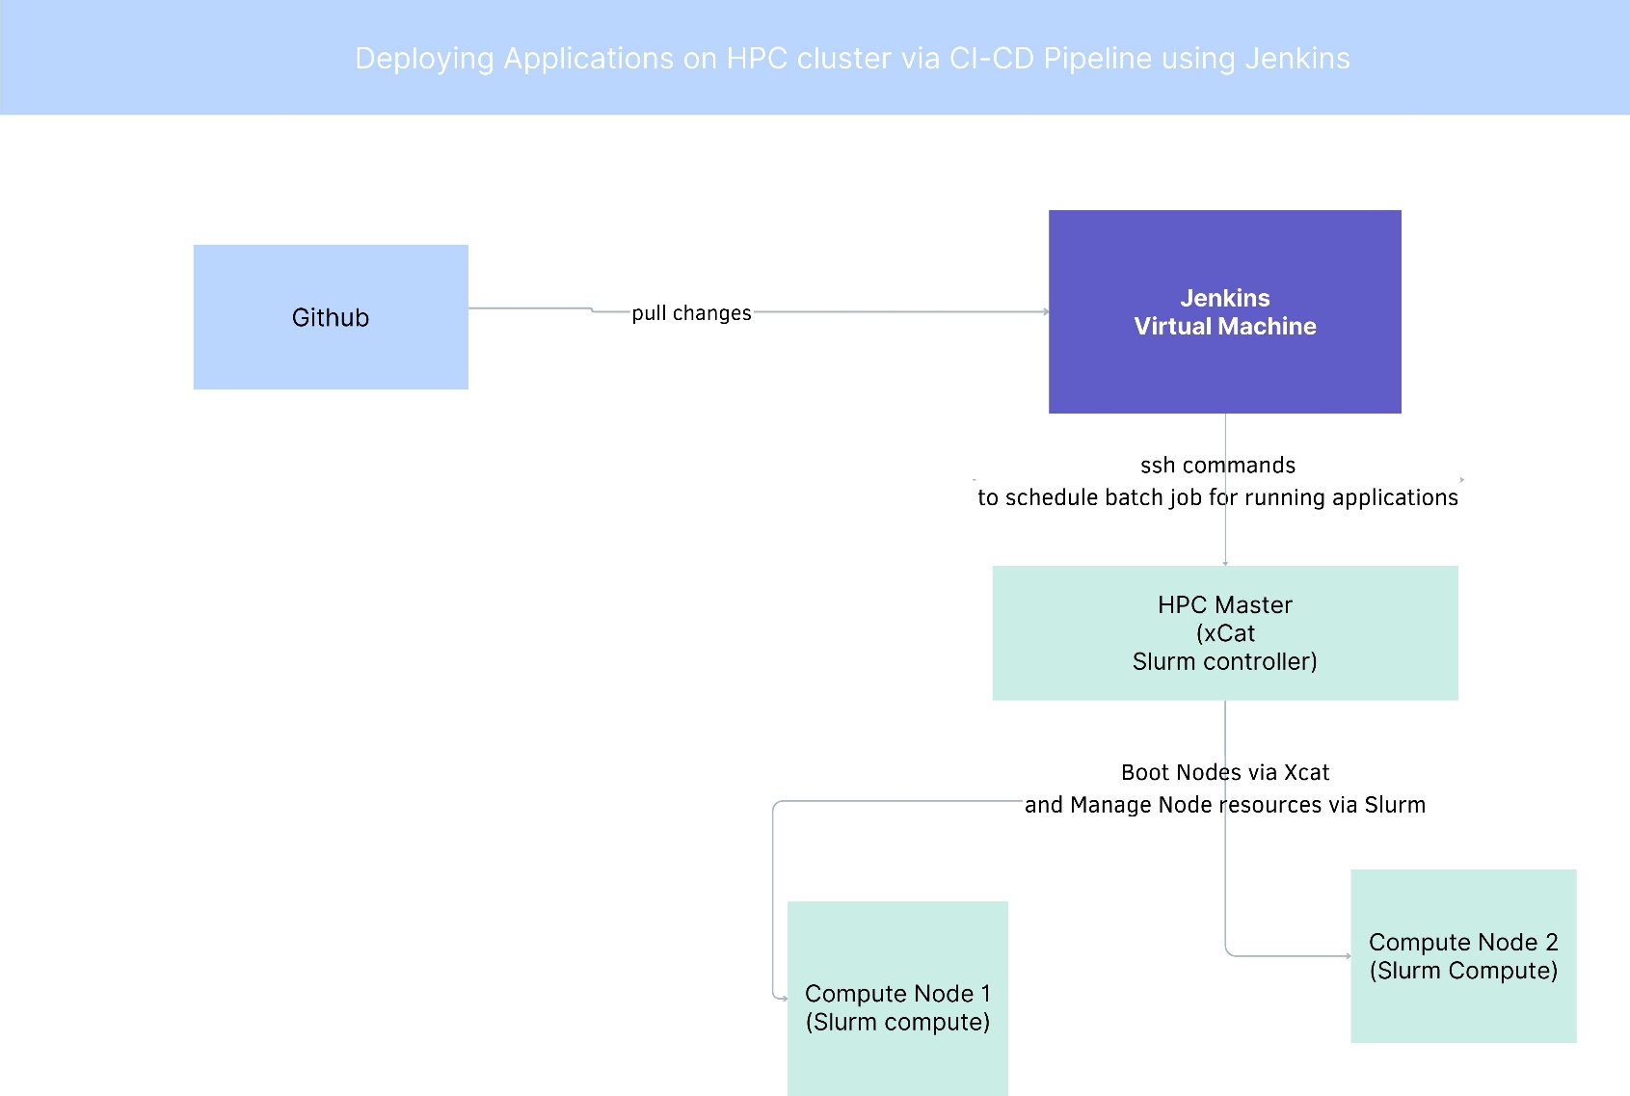
System Architecture

Slide 6
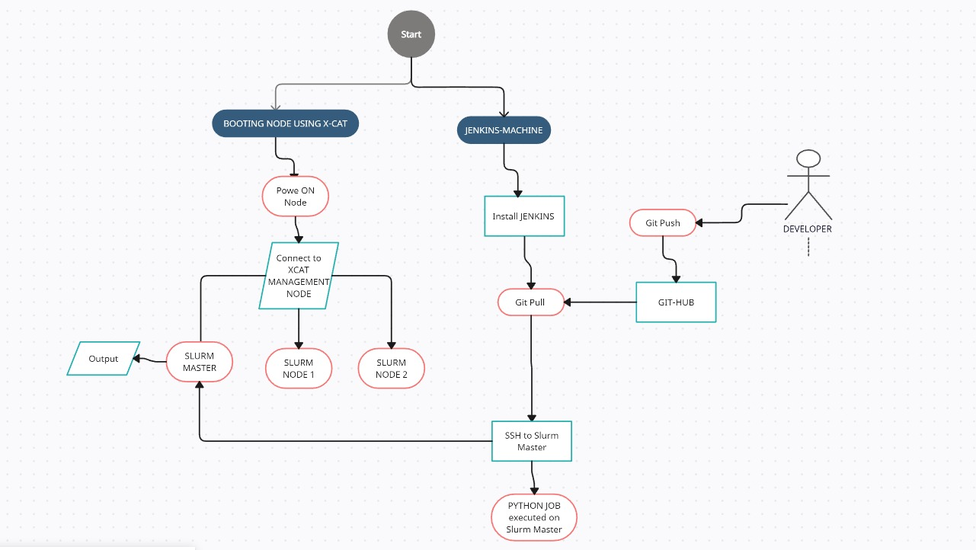
Activity Architecture

Slide 7
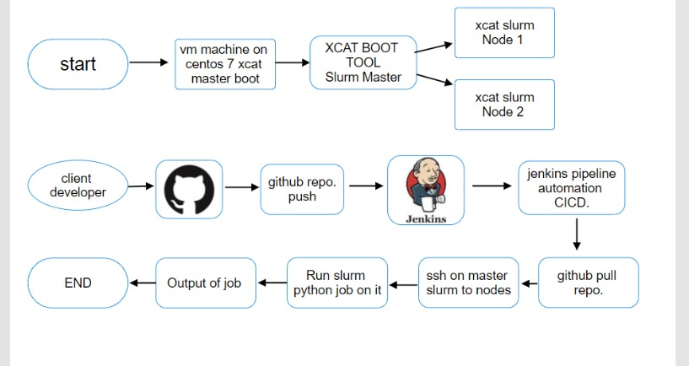
Process Flow Diagram

Slide 8
xCat
xCAT (Extreme Cloud Administration Toolkit) is open-source distributed computing management software developed by IBM, used for the deployment and administration of Linux or AIX based clusters.
Hpc cluster which would be made by xcat node provisioning and its resources had to be managed for that we decide to use Slurm.

Slide 9
IPtables
`iptables` is a versatile and powerful tool that acts as a firewall for managing network traffic in Linux-based systems. It uses tables to organize sets of rules, called chains, to determine how to treat network packets. The three primary tables are `filter`, `nat`, and `mangle`, but we'll focus mainly on `filter` for basic firewall functionalities and `nat` for network address translation, which are pertinent to your query about enabling forwarding, NAT rules, and allowing every input in the input chain.
Key Tables and Chains
- Filter Table The default table, which contains the `INPUT`, `OUTPUT`, and `FORWARD` chains for packet filtering.
- NAT Table: Used for network address translation, containing `PREROUTING`, `POSTROUTING`, and `OUTPUT` chains.
Enabling IP Forwarding
Setting Up NAT
Enabling Packet Forwarding

Slide 10
Jenkins
Jenkins is an open-source automation server that facilitates Continuous Integration and Continuous Deployment (CI/CD) practices. It enables developers to build, test, and deploy their software automatically, thereby increasing efficiency and reducing the likelihood of errors. Jenkins supports a wide array of plugins that extend its capabilities, making it highly customizable and adaptable to various development needs.
We identified that we needed Jenkins Machine (Production Machine) which will deploy applications on Hpc cluster.

Slide 11
NFS
Network File System (NFS) is a distributed file system protocol that allows a user on a client computer to access files over a network in a manner similar to how local storage is accessed.
Configured common storage for Hpc Cluster so that files remain same everywhere via NFS

Slide 12
Slurm on HPC Cluster
Slurm (Simple Linux Utility for Resource Management) is an open-source, fault-tolerant, and highly scalable cluster management and job scheduling system for Linux clusters. It is widely used in HPC environments to allocate resources, manage job queues, and schedule job execution, optimizing the utilization of available computing resources.
Hpc cluster which would be made by xcat node provisioning and its resources had to be managed for that we decide to use Slurm

Slide 13
Jenkins Pipeline
pipeline{
agent any
stages{
stage('fetch-code’){
steps{
sh '''
ssh root@192.168.144.213 'cd /nfs/slurm-rpms/HPC-SLURM/ && git pull'
'''
}
}
stage('Run-code'){
steps{
sh '''
ssh root@192.168.144.213 'pip3 install virtualenv && cd /nfs/slurm-rpms/ && virtualenv venv && source venv/bin/activate && pip3 install numpy pandas sklearn && sbatch myscript1.sh'
'''
}
}
}
}

Slide 14
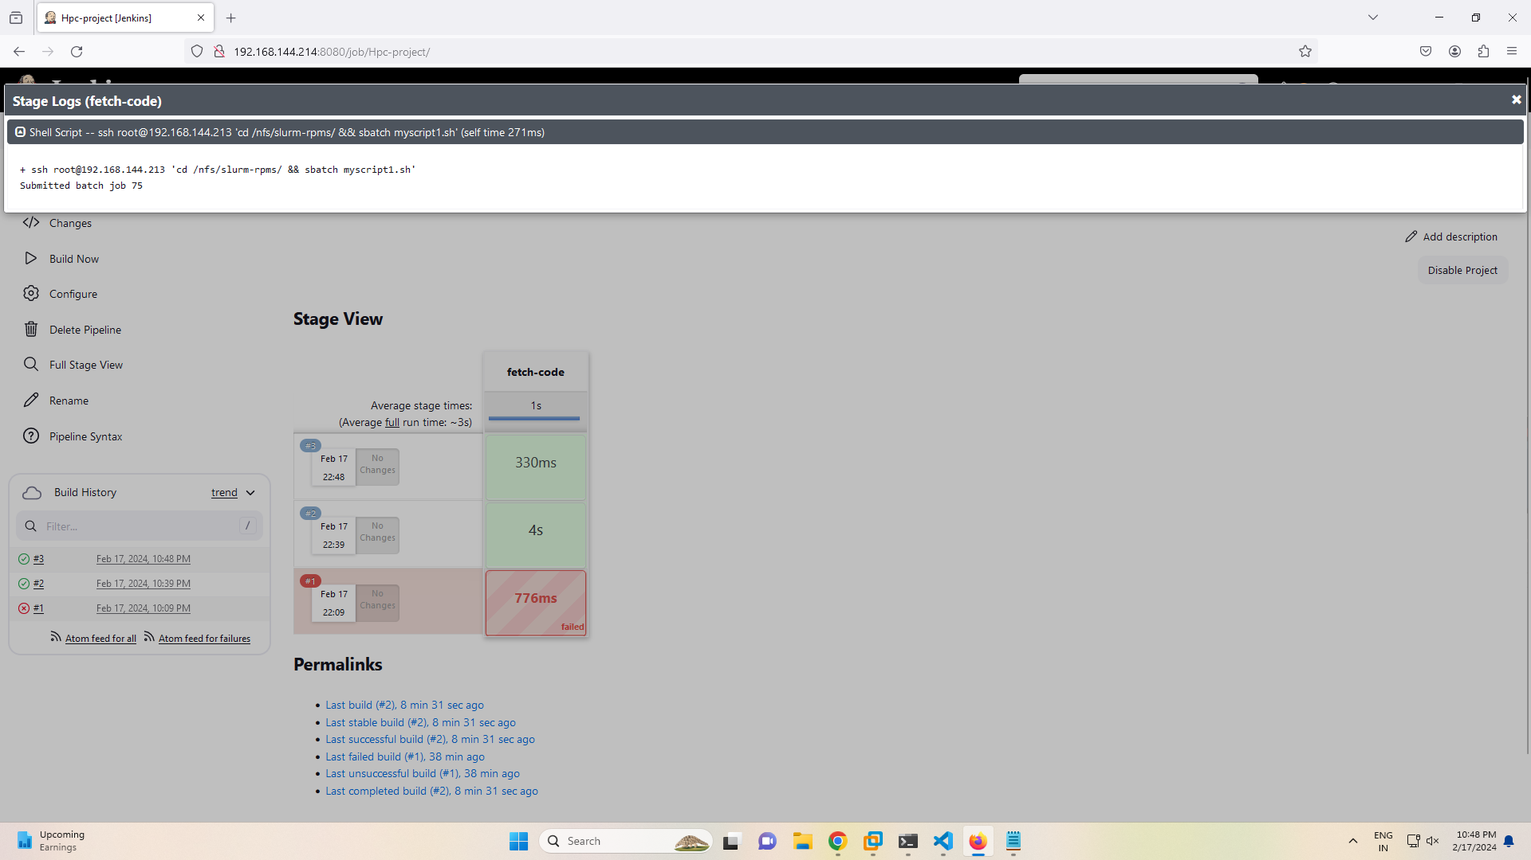
Output

Slide 15
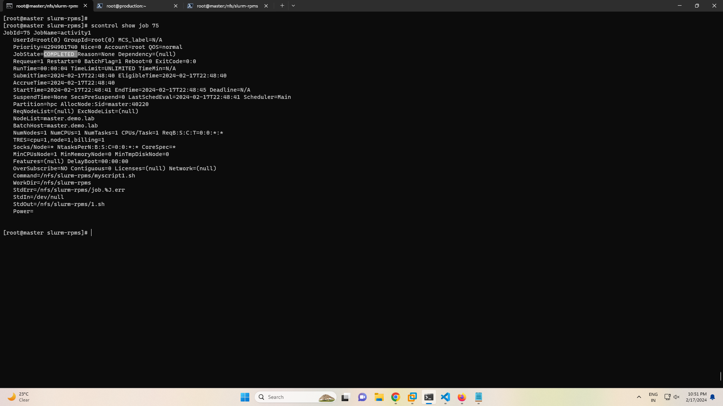
Output

Slide 16
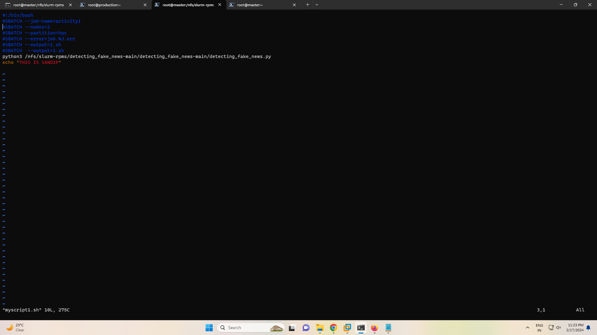
Output

Slide 17
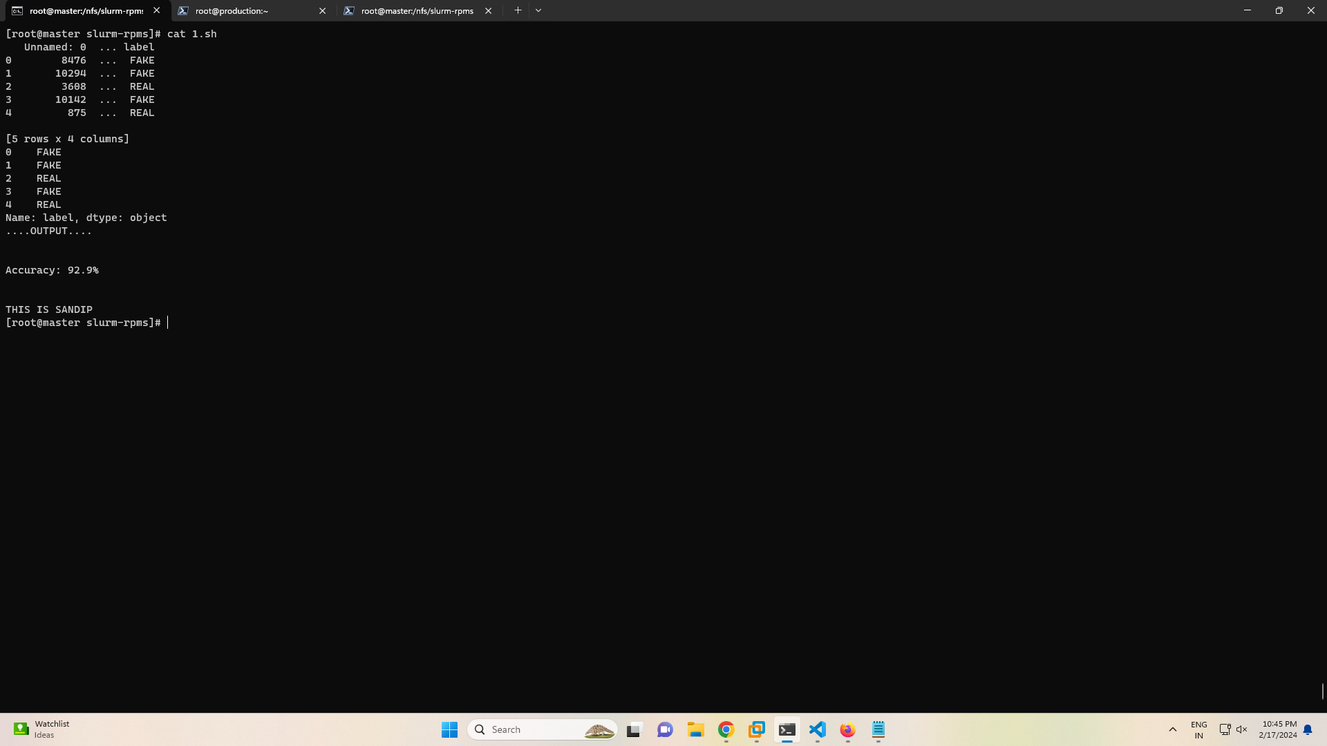
Output

Slide 18
Thank You

